Slide 1
MACS Instrument simulation
Mads Bertelsen, ESS DMSC

Slide 2
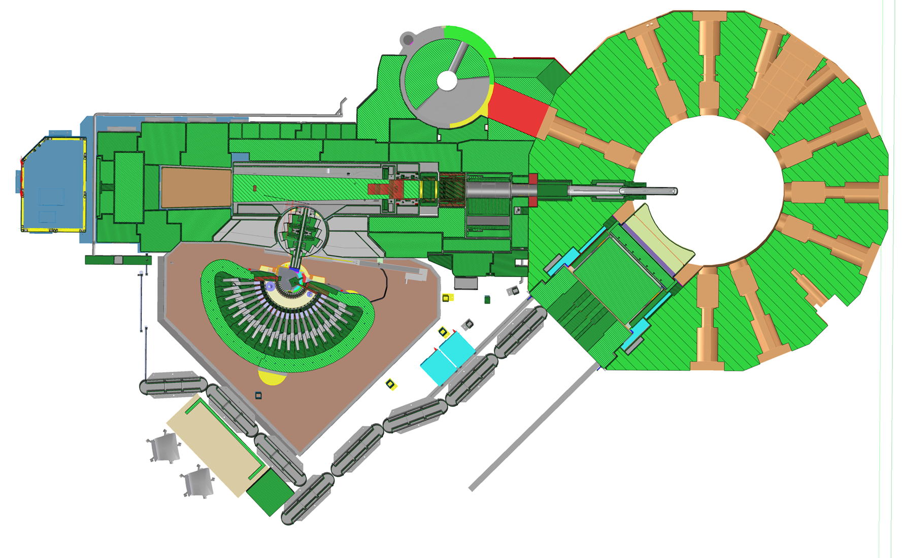
MACS at NIST in Washington, USA
Reactor
Moderator
Monochromator position
Beamstop
Guide
Sample environment
Kidney
Image from NIST webpage

Slide 3
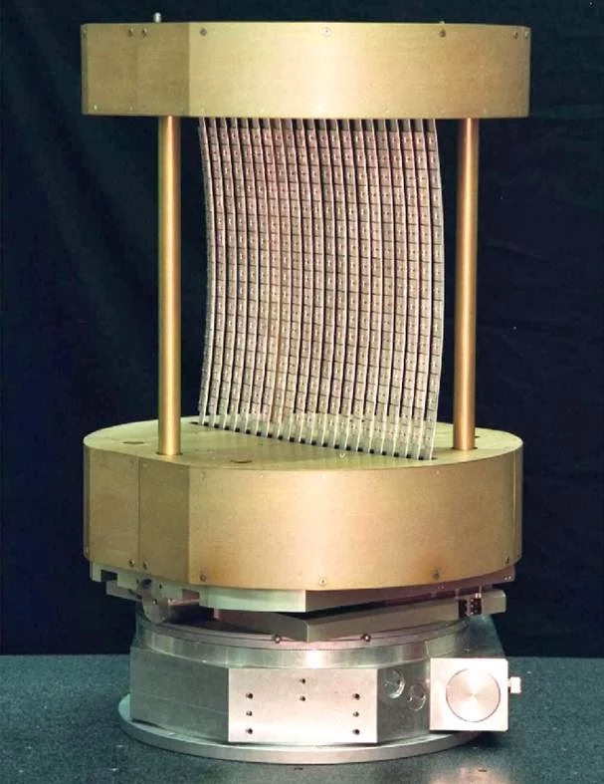
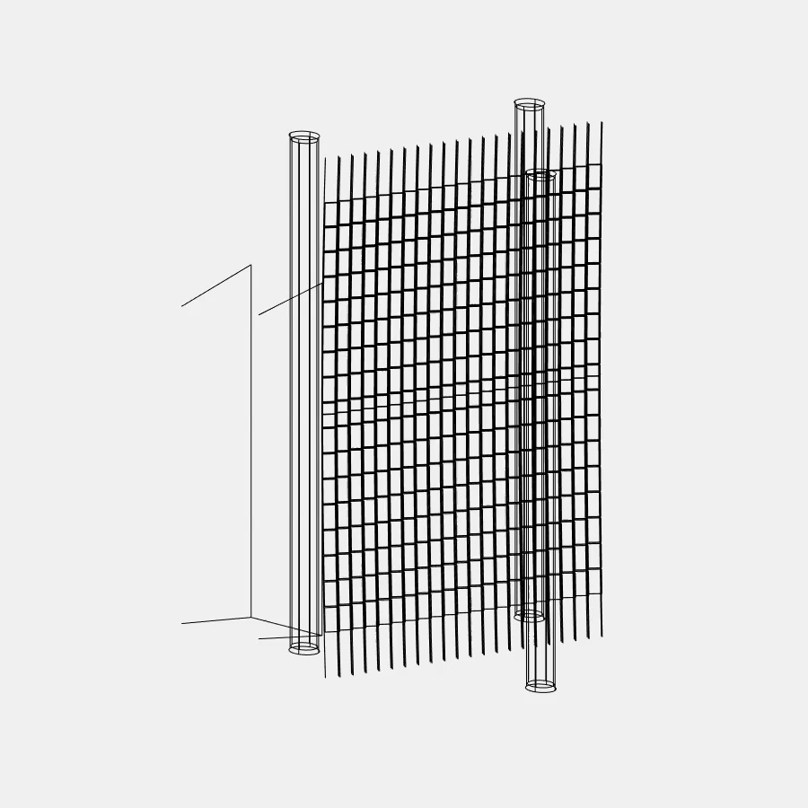
MACS
Image from NIST webpage

Slide 4
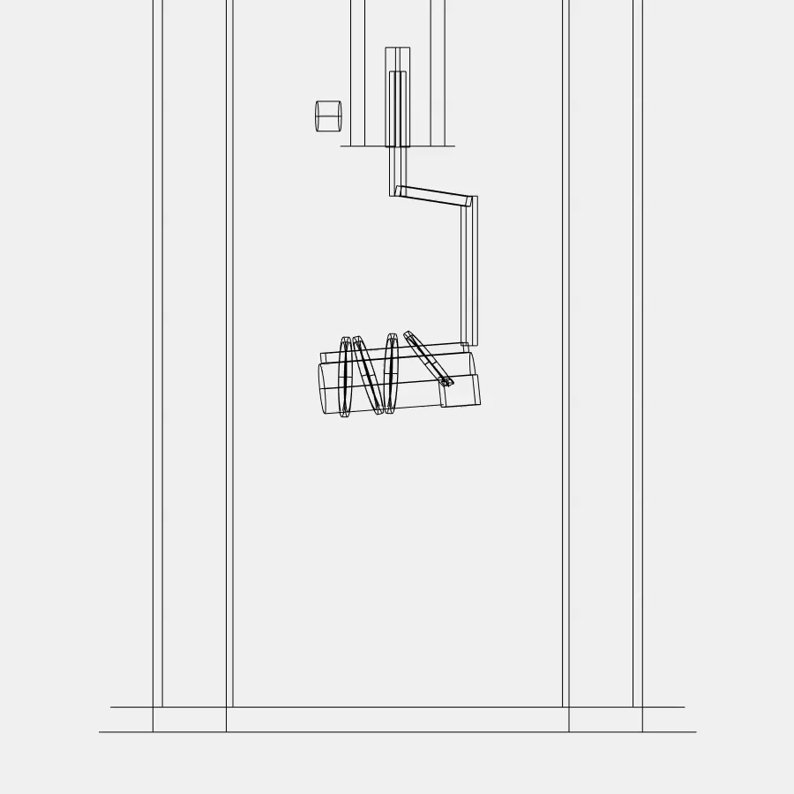

Slide 5
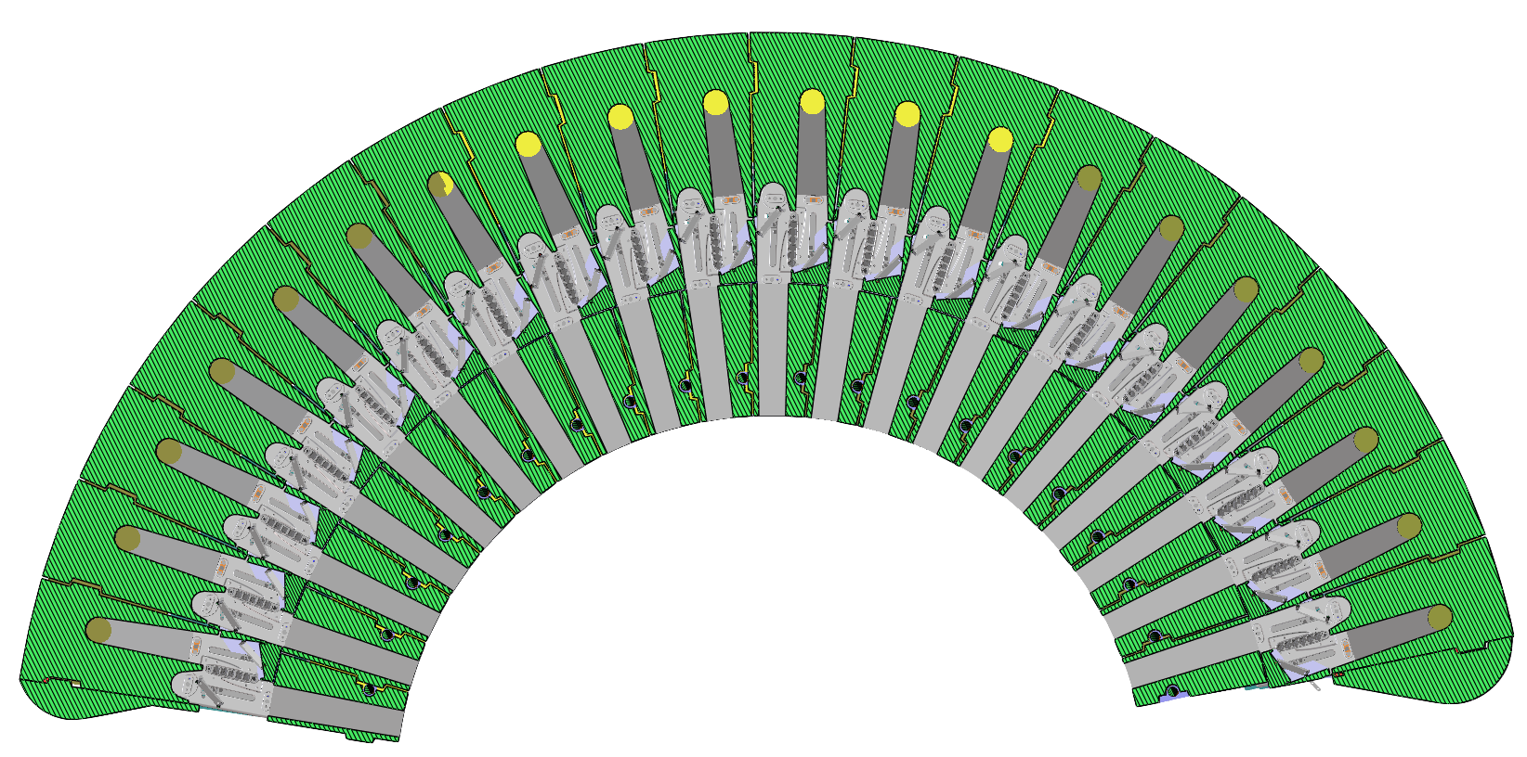
MACS
CAD model of instrument backend
McStas model of instrument backend
More than 600 geometries
2 Union master components

Slide 6
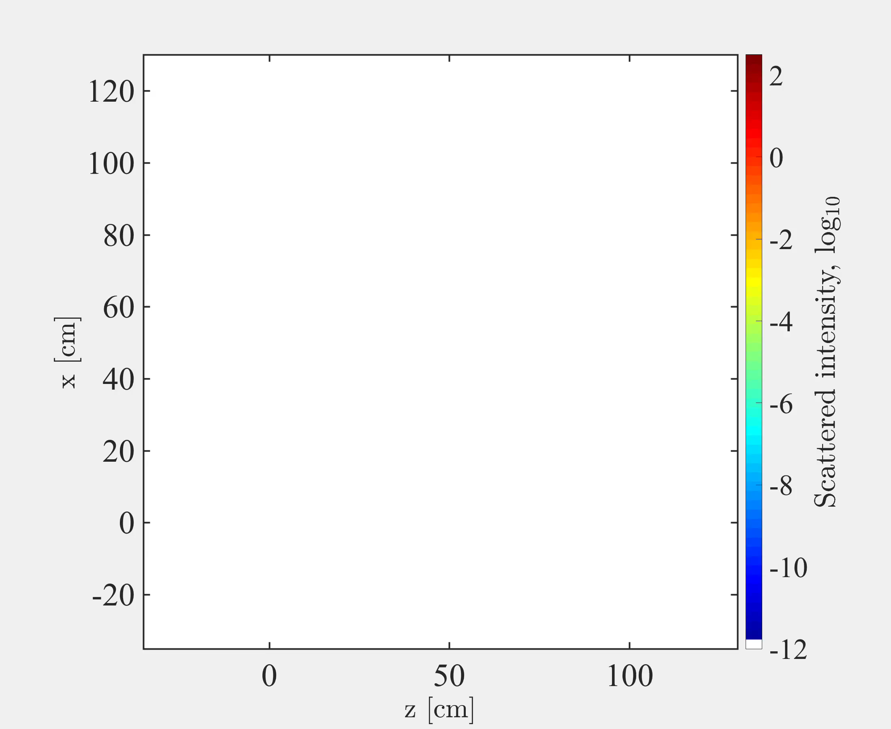
MACS
Elastic incoherent air sacttering
Monochromator 5 meV
Analyzer 5 meV
Instant pulse from source

Slide 7
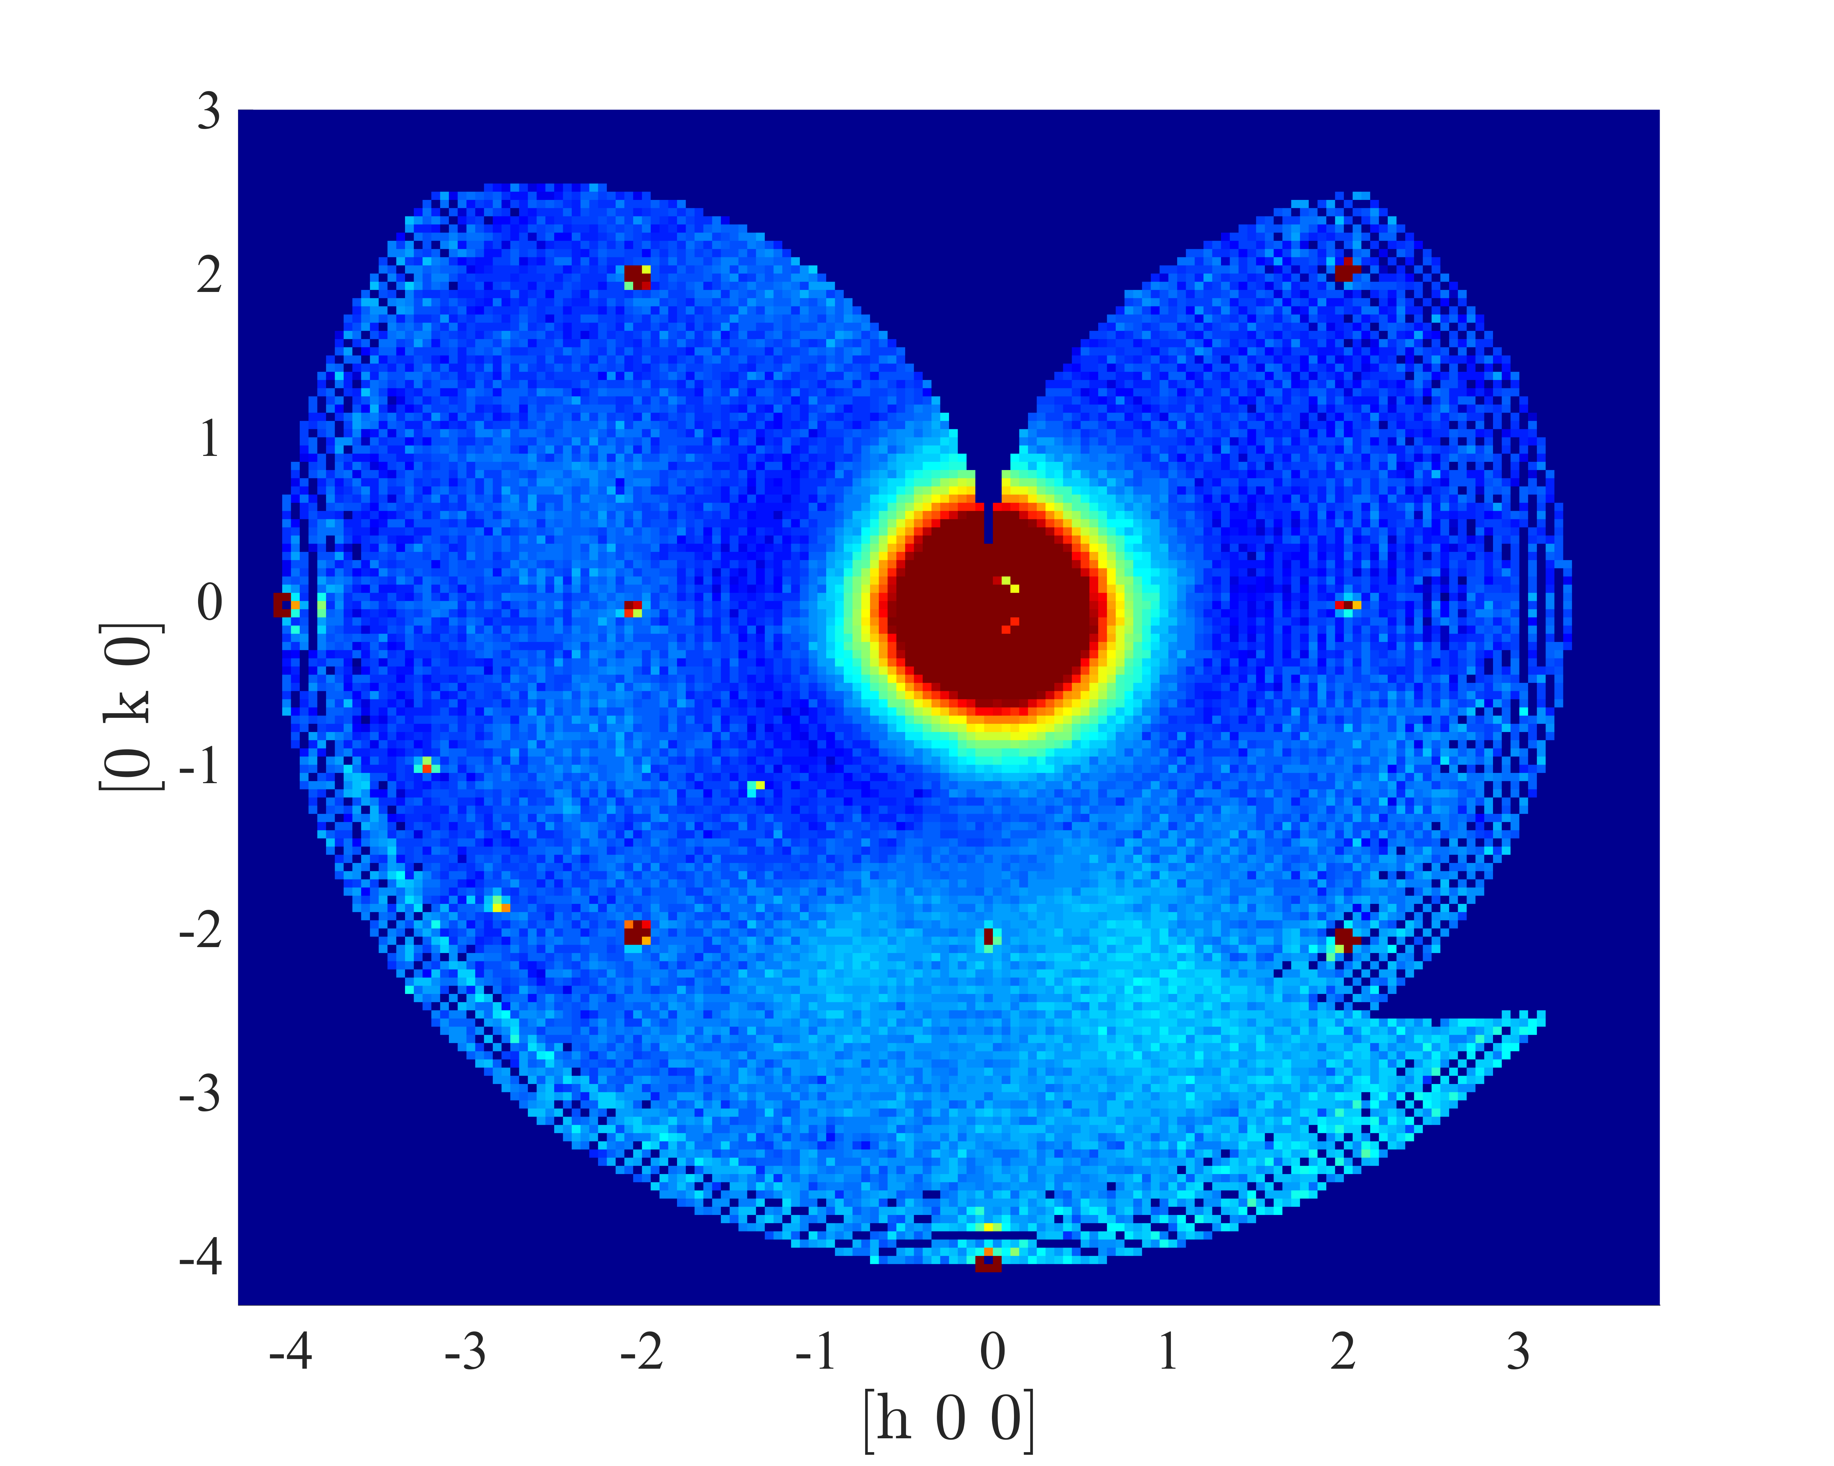
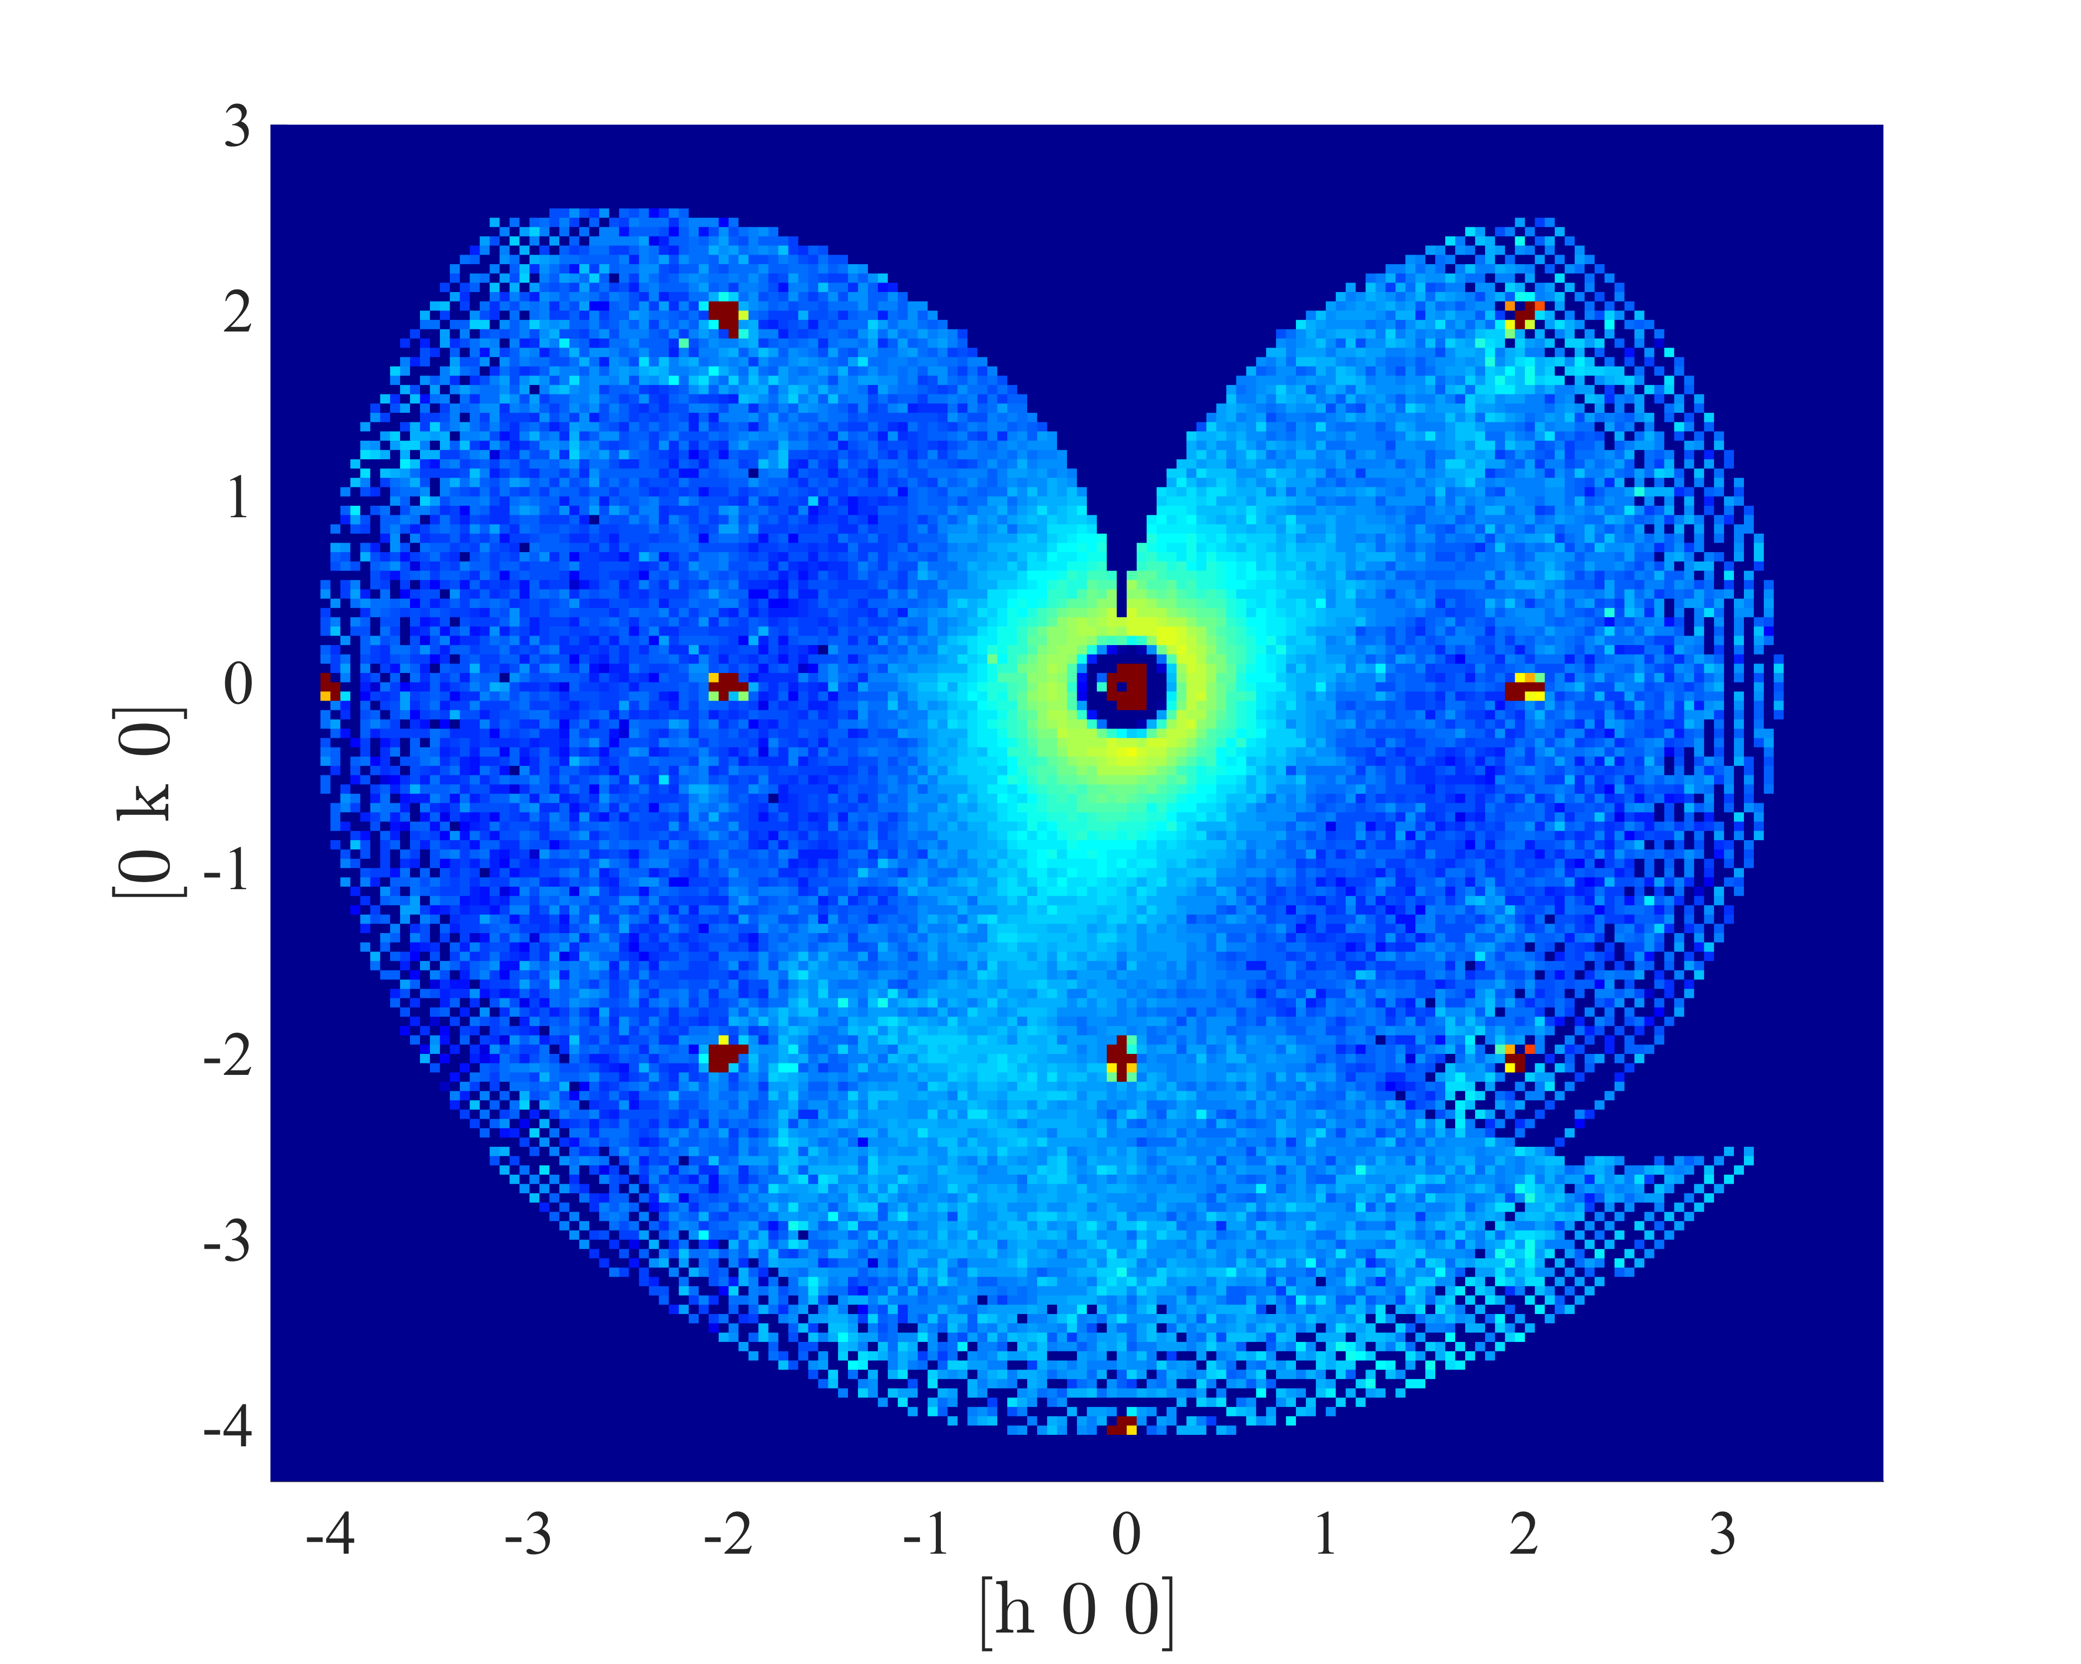
MACS Results
Measurement
Simulation

Slide 8
Conclusion
Use Union components for complex geomtries or for modular physics
Performs full multiple scattering simulation
Slower than typical McStas simulations, but still runs well on a laptop
Strong visualization tools
Easier to contribute physics

